Slide 1



NHA-256
NHA-256 URL Shortener with Built-in Observability
Mohamed Attia Hassan
Mohamed Hosni Mohamed
Abdulrahman Gomaa Mahmoud
Start Slide
github.com/nhahub/NHA-256

Slide 2
NHA-256
Team Members & Roles
• Mohamed Hosni Mohamed: Flask Backend & Docker Containerization Led the development of the Flask API, URL shortening logic, redirect handling, and full Docker + Docker Compose setup.
• Mohamed Attia Hassan: Prometheus Monitoring, Metrics & Alerting Designed and implemented all Prometheus metrics, custom exporters, alerting rules, and integration with the Flask app.
• Abdulrahman Gomaa Mahmoud: User Interface & Grafana Dashboard Built the clean web interface and designed the production-grade Grafana dashboard with real-time graphs for latency, traffic, and errors.
NHA-256

Slide 3



NHA-256
Why a URL Shortener
+ Monitoring?
(Project Idea & Goal)
Idea: Create a simple, reliable URL shortener for easier sharing in marketing, APIs, and social media.
Goal: Combine it with advanced monitoring to track performance (latency, errors, traffic) in real-time, making it production-ready for devs and businesses.
NHA-256

Slide 4

NHA-256
1
Fully working URL shortener
Project Goals
2
Expose rich Prometheus metrics
3
Ready-to-use Grafana dashboard
4
One-command deployment with Docker Compose
NHA-256

Slide 5
NHA-256
System Architecture
USER
Prometheus
Flask API
Grafana
NHA-256

Slide 6



NHA-256
Tech Stack & Tools
Flask (Python)
Docker + Compose
Lightweight micro-framework that powers the API, URL shortening logic, and /metrics endpoint.
Full environment packaged into containers. One command (docker compose up) starts Flask + Prometheus + Grafana.
Prometheus
Grafana
Pull-based monitoring system that scrapes metrics from Flask and stores them as time-series data.
Beautiful pre-built dashboard that visualizes latency, request rates, errors, and health metrics in real time.
NHA-256

Slide 7



NHA-256
What Makes NHA-256 Production-Ready from Day One
Minimal stack, maximum observability.
Full Observability
Zero-Setup Deployment
Built for Scale
Real-time dashboard with latency percentiles, request rates, error tracking, and health metrics – all pre-configured
docker compose up --build → Flask + Prometheus + Grafana running instantly on any machine
Add Redis/Postgres → horizontal replicas → Kubernetes in minutes. No code changes needed
NHA-256

Slide 8

NHA-256
Shorten
01
User sends any long URL → Flask instantly generates a unique short code (e.g., /L5IQI7)
How NHA-256 Works – 3 Simple Steps
02
Click & Redirect
Anyone opens the short link → gets redirected to the original URL in < 50 ms
03
Monitor Everything
Prometheus + Grafana track every request, latency, errors, and health in real time
NHA-256

Slide 9
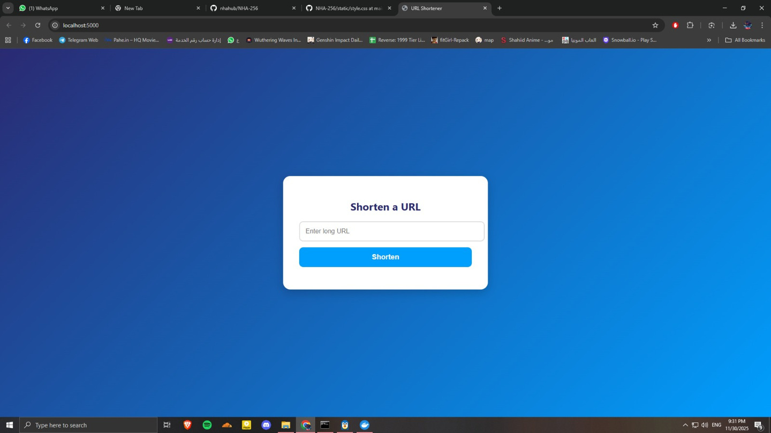
Live Demo – It Actually Works!
Simple Web Interface
NHA-256
Enter any URL → instantly get a short link (e.g., /L5IQI7)
Everything you’re about to see is running locally right now with a single docker compose up
Real-time Grafana Dashboard
Tracks creations/sec, redirects, latency percentiles & errors live
Prometheus Metrics Endpoint
Raw metrics exposed at localhost:5000/metrics – no extra setup
NHA-256

Slide 10
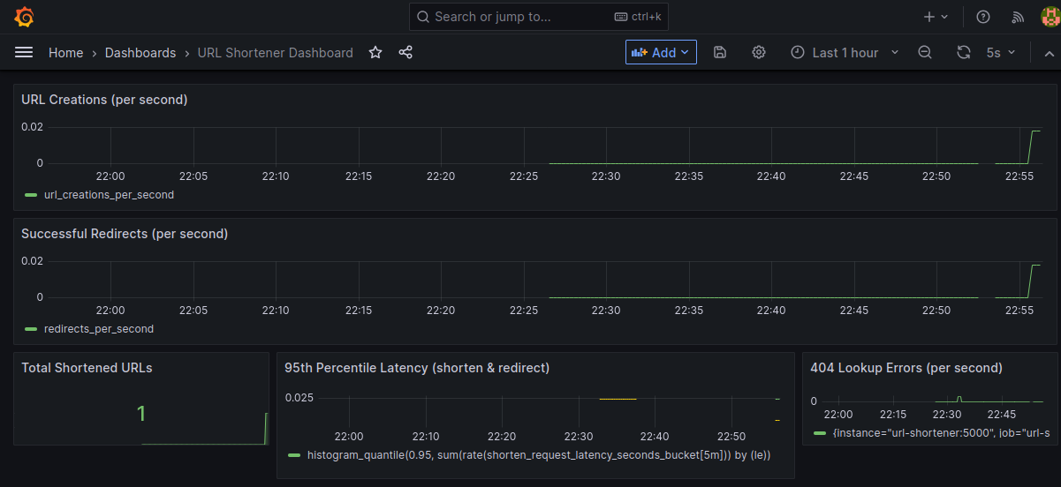
Live Demo – Grafana Dashboard
NHA-256
Real-time Monitoring Dashboard
Request rates · Latency percentiles · Error tracking – all live
NHA-256

Slide 11
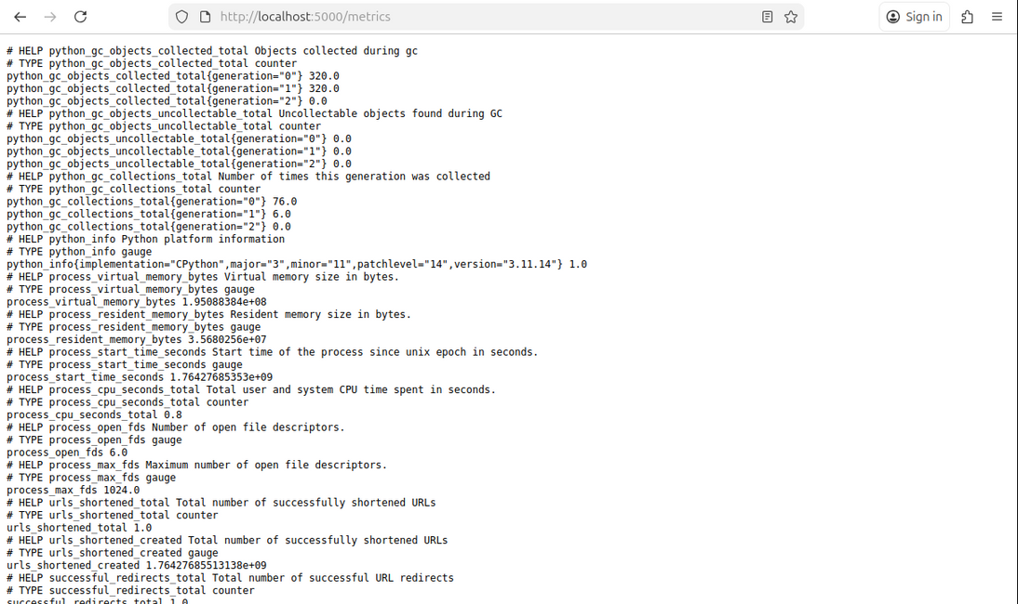
NHA-256
Live Demo – Raw Metrics
Prometheus Metrics Endpoint
No extra tools. Just open /metrics
NHA-256

Slide 12
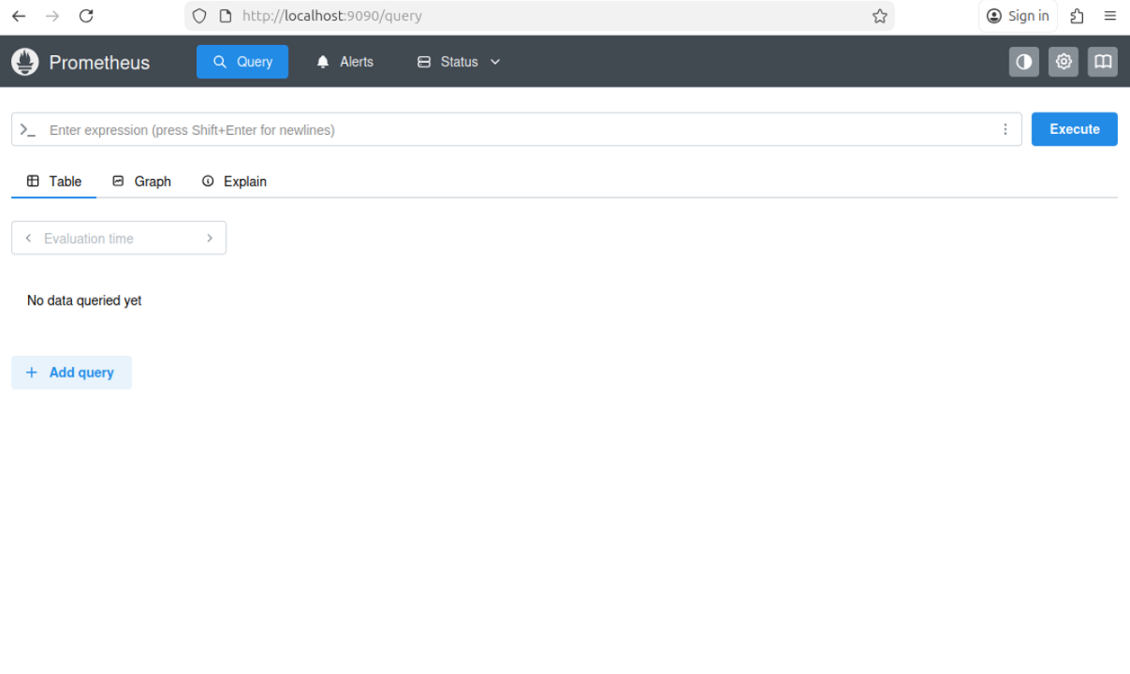
NHA-256
Live Demo – Prometheus UI
Explore Anything with PromQL
Graph, query, and alert on every metric
NHA-256

Slide 13
NHA-256
Run in 30 Seconds
text
Bash
→ Flask API → http://localhost:5000
→ Grafana → http://localhost:3000 (admin / admin)
→ Prometheus → http://localhost:9090
git clone https://github.com/nhahub/NHA-256.git
cd NHA-256
docker compose up --build
Works instantly on Windows · macOS · Linux No Python, no dependencies, no setup.
NHA-256

Slide 14
NHA-256
Future Ideas for Marketing & Development
Development:
• Add persistent DB (Redis/PostgreSQL) for production.
• Custom aliases, expiration, & analytics.
• Authentication & load balancing.
• Kubernetes deployment for scaling.
Marketing:
• Open-source on GitHub for community contributions.
• Pitch as free tool for devs/marketers via blogs (e.g., Dev.to).
• Partner with URL services; add premium features (e.g., paid analytics).
• Demo videos on YouTube/X; target startups for adoption.
NHA-256

Slide 15


NHA-256
Thank You for Your Time
Deep Insights
github.com/nhahub/NHA-256
Mohamed Attia Hassan
Mohamed Hosni Mohamed
Abdulrahman Gomaa Mahmoud

